Slide 1

Tableau Module Presentation
Data source, Dimensions & Measures
Group - 2
Divakar
Adesh Lakade
Shravani Bhosale
Bhoomi Gohil

Slide 2
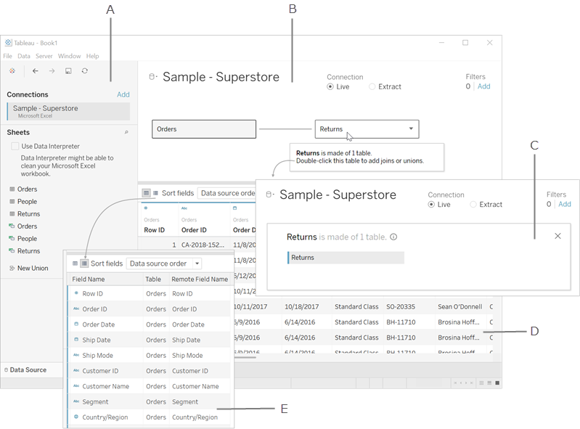
DATA SOURCE
It acts as a bridge between Tableau and your raw data
It helps Tableau connect to different types of data (Excel, CSV, Databases, Cloud, etc.).
A Data Source can include multiple connections across databases or files.
When connected to Excel, it displays all the available sheets and named ranges.
You can drag tables into the canvas to create a unified dataset for analysis.
Divakar

Slide 3
Canvas
1. Data Combining
Area where you drag and drop tables from your data connections.
Used for data combining techniques like Joins (Inner, Left, Right, Full) and Unions.
Let’s you define relationships between multiple tables or data sources.
Provides a visual view of your schema (how tables are connected).
2. Metadata
3. Data Preview Pane
Data Types: # - Number, ABC - Text,
Calendar - Date, T/F - Boolean, Globe - Geo fields
Field Name: Can be renamed in Tableau
Physical Table: Shows the table name in source
Remote Field: Original name from source (cannot rename)
Displays a sample of the underlying data from your source (not the entire dataset, just a preview).
Rename fields, Copy and paste values
It allows to quickly verify data quality
Hide or split fields and Add Aliases for values
Divakar

Slide 4
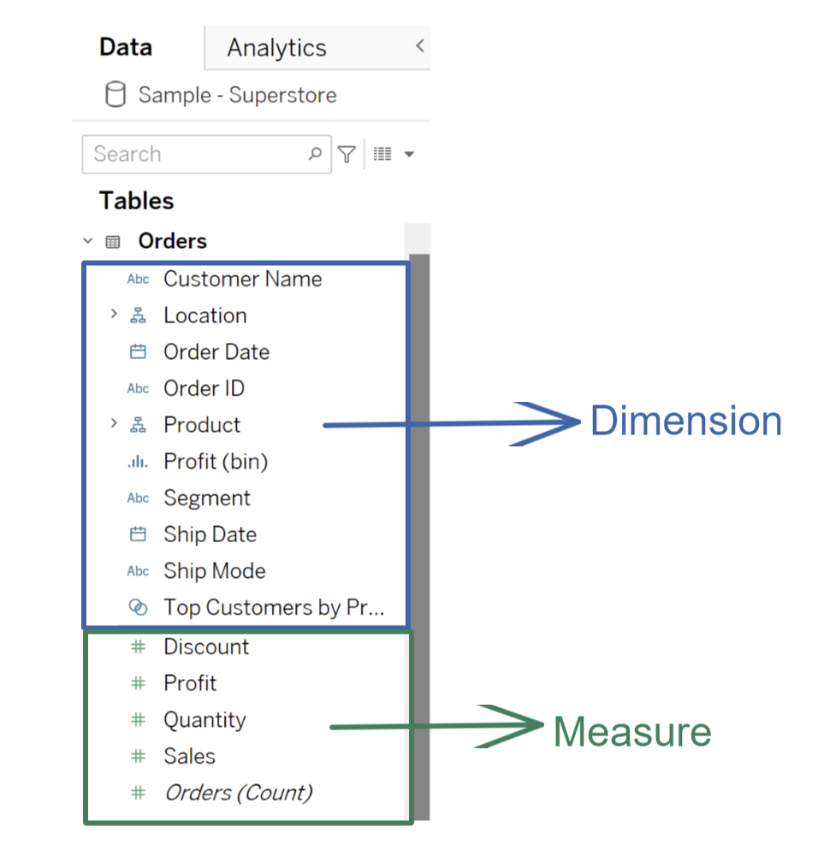
Dimension / Discrete field
Dimensions are qualitative or categorical fields.
They describe "what" the data is about (categories, labels, attributes).
They cannot be aggregated
Some numbers may also be treated as dimensions. Like, Aadhar numbers, Account numbers, Age, etc
They are shown in blue colour
Examples: Product Name, Customer ID, Country, City, Order Date.
Bhoomi gohil

Slide 5
Measure /
Continuous
Measures are quantitative or numeric fields.
They represent values that can be aggregated (SUM, AVG, MIN, MAX).
Measures are used for calculations, graphs, and trends.
Values keep incrementing and can be aggregated.
Typically shown in green colour in Tableau.
Examples: Sales, Profit, Quantity, Discount.
Bhoomi gohil

Slide 6
Comparison Between
Dimensions
Measures
Describes data (categories)
Describe “what” the data is about
Usually discrete (fixed values)
Cannot be aggregated (no SUM, AVG)
Used for grouping, filtering, slicing data
Shown as Blue pills in Tableau
Often used on Rows/Columns to create categories
Best suited for labels, headers, categories
Quantifies data (numbers)
Describe “how much” or “how many”
Usually continuous (range of values)
Can be aggregated (SUM, AVG, MIN, MAX)
Used for calculations, metrics, KPIs
Shown as Green pills in Tableau
Often used on Rows/Columns to create axes or size
Best suited for charts, trends, and aggregations
Adesh Arun Lakade

Slide 7
Data Source provides raw data
Dimensions categorize & filter
Relationship Between Them
Measures calculate metrics
Together they create meaningful
visualizations
Shravani Bhosale

Slide 8
Uses Cases / Examples
Retail: Region (Dimension) + Sales (Measure)
Healthcare: Patient Age Group (Dimension) + Average Recovery Time (Measure)
Finance: Account Type (Dimension) + Total Transactions (Measure).
Education: Course Name (Dimension) + Number of Enrolments (Measure).
Shravani Bhosale

Slide 9
Thankyou All

